Slide 1
NLP, LLM, and Scraping Fusion: Advancing HR Systems for Job Description Synthesis and Candidate Profiling
Dhruti Ambekar 20BCP001
Mentor : Dr. Payal Chaudhari

Slide 2
abstract
This HR Web Application revolutionizes candidate selection through its three core modules: LLM, Web Scraping, and NLP & Stack Ranking.
Leveraging LLM, the system generates Job Description (JD) by prompt provided by the HR.
Web Scraping automates data collection from platforms like LinkedIn and Indeed, compiling comprehensive candidate datasets. The NLP & Stack Ranking module evaluates candidate suitability based on job descriptions, employing advanced natural language processing techniques.
Together, these modules streamline the recruitment process, offering HR professionals unparalleled efficiency and precision in identifying the most promising candidates for roles within the organization.

Slide 3
About company
Adani Enterprises, a prominent Indian conglomerate established by Gautam Adani in 1988, boasts a diversified portfolio spanning energy, infrastructure, logistics, agribusiness, defense, and digital sectors.
Renowned for its ambitious growth strategies and innovative projects, the company operates globally, undertaking ventures in countries such as Australia, Indonesia, and Bangladesh.
With a focus on digital transformation alongside traditional sectors like coal mining, renewable energy, port management, and real estate development, Adani Enterprises continues to make significant contributions to economic development regionally and internationally.

Slide 4
Problem statement
- The conventional candidate selection process for HR professionals is burdened with inefficiencies and manual labor. Matching candidate profiles to job descriptions is time-consuming and error-prone, often resulting in delays and mismatches.
- Passive candidate sourcing poses challenges for HR professionals primarily due to the need for proactive outreach. Identifying and accessing passive candidates typically involves navigating through various online platforms and networks where they may be present, which can be time-consuming and require specialized skills.
- HR professionals require an automated solution capable of swiftly and accurately matching candidate profiles to job descriptions, streamlining passive candidate data collection, and providing actionable insights for efficient recruitment processes.
- The current landscape necessitates a transformative approach to optimize candidate selection and enhance organizational productivity.

Slide 5
Project Description
Our project aims to develop a comprehensive HR Bot Web Application designed to revolutionize the candidate selection process within our organization. The application comprises three key modules: LLM, Web Scraping, and NLP & Stack Ranking.
The LLM module we generate the Job Description with the information provided aiding accurate candidate matching
The Web Scraping module automates data extraction from online job platforms compiling a rich dataset of passive candidates. This streamlines the sourcing process, providing HR professionals with a vast pool of potential talent to explore.
The NLP & Stack Ranking module employs advanced natural language processing techniques to evaluate candidate profiles against job descriptions. By conducting text classification and stack ranking, this module identifies the most suitable candidates, facilitating informed hiring decisions.
Through seamless integration of these modules, our HR Bot Web Application aims to streamline the recruitment process, improve decision-making accuracy, and ultimately elevate organizational productivity by ensuring the right candidates are selected for the right roles.

Slide 6
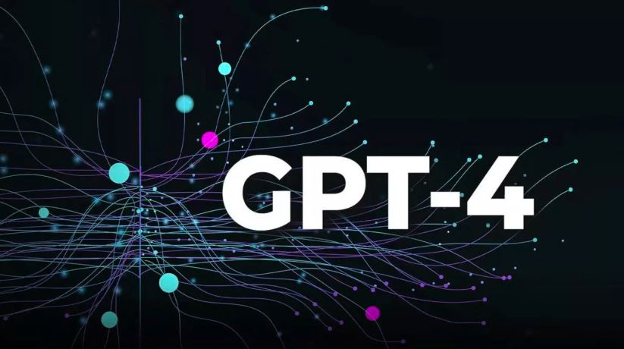
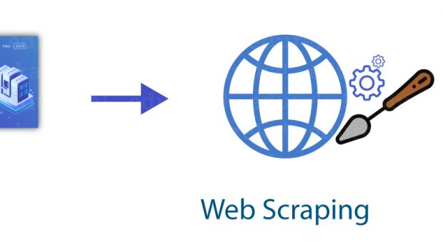
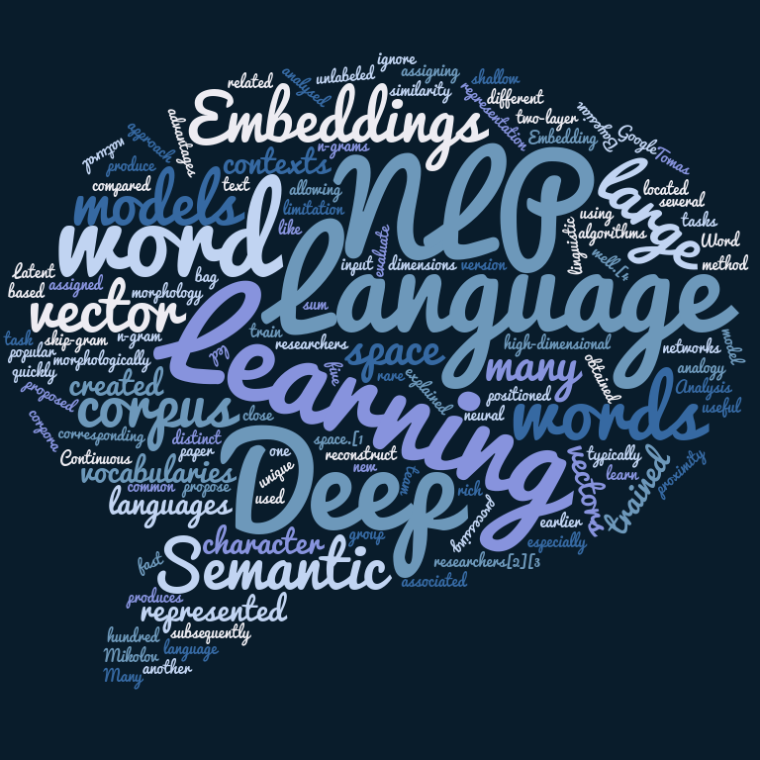
Underlying Technology
Module 1
Module 2
Module 3
HR provides prompts to the LLM model, employing NLP for language understanding. The LLM generates the Job Description with the information provided aiding accurate candidate matching.
An LLM processes a prompt by predicting the most fitting next words or tokens based on extensive linguistic knowledge encoded in its parameters, mimicking human-like language patterns and semantics through deep learning techniques.
Web scraping involves the automated extraction of data from websites.
Various tools and libraries are employed to scrape candidate information from online job platforms.
These tools enable the application to gather candidate data efficiently, creating a comprehensive repository for analysis and evaluation.
NLP techniques are applied to analyze candidate profiles and job descriptions, extracting key features and attributes.
Additionally, machine learning algorithms are utilized for text classification and stack ranking of candidate profiles.
By leveraging NLP and ML technologies, the module evaluates candidate suitability based on semantic understanding and ranks them according to their alignment with job description.

Slide 7





PLAN FOR PRODUCT LAUNCH
PLANNING
MARKETING
DESIGN
STRATEGY
LAUNCH
Synergize scalable e-commerce
Disseminate standardized metrics
Coordinate e- business applications
Foster holistically superior methodologies
Deploy strategic networks with compelling e- business needs

Slide 8
TIMELINE
SEP 20XX
NOV 20XX
JAN 20XX
MAR 20XX
MAY 20XX
Synergize scalable e-commerce
Disseminate standardized metrics
Coordinate e- business applications
Foster holistically superior methodologies
Deploy strategic networks with compelling e- business needs

Slide 9
AREAS OF FOCUS
B2B MARKET SCENARIOS
CLOUD-BASED OPPORTUNITIES
Develop winning strategies to keep ahead of the competition
Capitalize on low-hanging fruit to identify a ballpark value
Visualize customer directed convergence
Iterative approaches to corporate strategy
Establish a management framework from the inside

Slide 10
THANK YOU
Mirjam Nilsson​
mirjam@contoso.com
www.contoso.com

